Slide 1
Sample size calculations and clustered data
Class 6
EDUC 265: Applied Regression Analysis
UCI School of Education

Slide 2
Announcement: Summary of final changes to the course
Reduced reading load.
Open-book exam.
Make-up points (50%, voluntary).
Additional accommodations for unexpected events: 11 out of 10 pts. on assignments, 30 out of 25 pts. on the exam (in addition to dropping one DAM and one reading reaction).
Additional review and repetition (and clearer labeling thereof).
Video recordings.
Additional guidance for final course projects.

Slide 3
Q&A

Slide 4
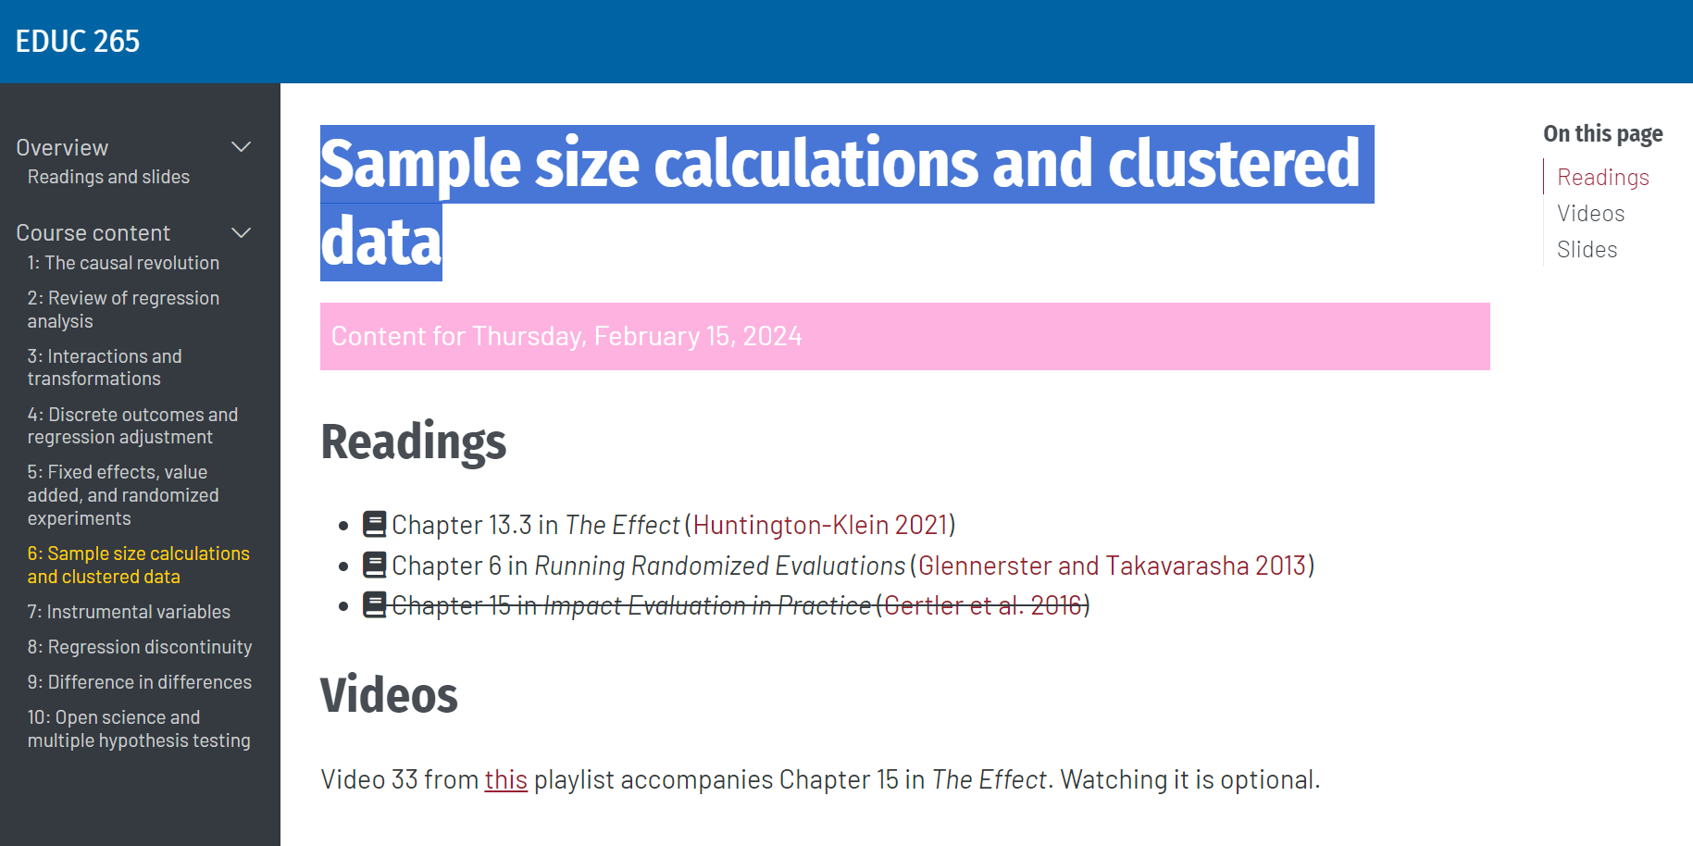

Slide 5
Acknowledgment
Today’s slide deck builds on my presentation at J-PAL South Asia’s 2019 Executive Education training course, in New Delhi, India.
Thanks to Rachel Glennerster, Anja Sautmann, and other colleagues at J-PAL for previous versions.

Slide 6
Outline
True and Estimated Treatment Effect [Review]
Distribution of Treatment Effect Estimates [Review]
Hypothesis Testing [Review]
Statistical Power and Sample Size
Power in Clustered Designs
Calculating Power in Practice
Notes:
Explain outline:
within section I, there will be an sampling exercise (not in breakout groups because we need the full class in the room)
[Ask J-PAL staff who will lead the exercise and hand over to them on slide 8.]
Explain that there will be a number of technical concepts introduced that are easier to understand with some stats background – focus on intuition if you don’t have that background.
Ask questions!

Slide 7
Outline
True and Estimated Treatment Effect
Distribution of Treatment Effect Estimates
Hypothesis Testing
Statistical Power and Sample Size
Power in Clustered Designs
Calculating Power in Practice

Slide 8
Estimating the true treatment effect with an experimental sample
Average in treatment group
The true treatment effect: difference in outcome with and without the program.
Average in control group
Estimates of the treatment effect from different samples
Estimated effect
Chance variation from sampling implies that the estimated effect is not always exactly equal to the treatment effect. How do we address that?
Notes:
Key motivation of this lecture:
The true effect is unknown
There is variation from sampling that affects treatment effect estimates –
how do we deal with this variation when we want to learn about the true effect?

Slide 9
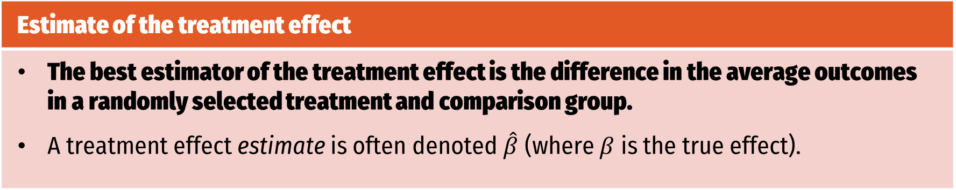
Estimating the treatment effect from a sample
Estimate of the treatment effect
The best estimator of the treatment effect is the difference in the average outcomes in a randomly selected treatment and comparison group. A treatment effect estimate is often denoted $\hat{β}$ (where $β$ is the true effect).
Method 1: Differencing
Method 2: Regression
Use OLS to regress the outcome variable on the variable indicating treatment (equal to 1 if treated, equal to 0 if not treated)
Average in treatment group
Average in control group
Notes:
Mention briefly that OLS can be used to estimate treatment effects – control for covariates – only for those with stats background.

Slide 10





Sampling variation and the treatment effect estimate
Randomization guarantees that treatment and control are not systematically different. They may still be different due to chance:
The treatment effect estimate will vary due to chance differences between the two groups.
Random sampling
Comparison
Population
Treatment
Notes:
Illustration of sampling variation that lead to chance differences between treatment and control, including in the outcome variable of interest.
Give an example: e.g. supplemental nutrition program and height.

Slide 11
Exercise: Sampling variation and the distribution of the treatment effect estimate

Slide 12
Outline
True and Estimated Treatment Effect
Distribution of Treatment Effect Estimates
Hypothesis Testing
Statistical Power and Sample Size
Power in Clustered Designs
Calculating Power in Practice
Notes:
After showing sampling variation:
The second important benefit of randomization besides removing systematic bias
It provides us with some knowledge about how the sample-based estimates of the treatment effect “behave”.
This allows us to back out some information about the true treatment effect from just one sample and estimate.

Slide 13


Case study: Evaluating the effect of a remedial education program in urban Indian schools on student learning
Photo: Putul Gupta | J-PAL
Photo: Arvind Eyunni | Pratham
Notes:
Revisiting balsakhi classes

Slide 14
Example: The distribution of standardized school test scores in urban Indian schools
Source: [Balsakhi remedial education program]
A sample of over 23,000 students shows the natural variation in standardized test scores (Data from the “Balsakhi” remedial education program).
Notes:
Explain: this is a very large trial where we have a lot of data (point out frequencies)
Note standardization: scores centered at 1 and some scores are negative. EX

Slide 15
Different random samples from the same population lead to different treatment effect estimates
Notes:
We can look at what would have happened if we had only smaller samples (n=200) and estimated treatment effects from those.
Each graph shows the distribution of test scores in the treatment group, and in the control group, and the difference in average scores
You can see wide variation in treatment effect estimates – one is even negative.
You also saw this in the sampling exercise before – small samples give different treatment effect estimates every time.

Slide 16
Estimated impact from one experiment
Notes:
Now suppose we ran many of these experiments and took the difference in treatment and control mean. Because of the dispersion of test scores, we would not get the same difference every time.
Each time we get a different treatment effect estimate.
We want to know think some more about how these treatment effect estimates ”behave”.
Or: what is the distribution of these estimates?

Slide 17
Three experiments, three estimated impacts

Slide 18
Six experiments, six estimated impacts

Slide 19
Many experiments: a distribution of estimates

Slide 20
Many experiments: a distribution of estimates

Slide 21
Many experiments: a distribution of estimates

Slide 22
Many experiments: a distribution of estimates
Notes:
We would slowly build up a distribution of estimates.
Statistical theory in fact tells us that this distribution is a normal, or Gaussian distribution
the average of all these estimates is equal to the true effect (no bias)
dispersion dictated by
the dispersion of individual outcomes in T and C (individual children’s test scores)
the size of the sample we use for each of our hypothetical experiments (dictates representativeness of each T and C for pop. As a whole)

Slide 23
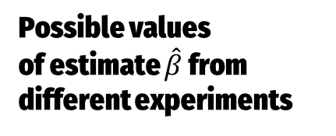
Distribution of estimates if the true effect is β
_{β}
Possible values
of estimate $\hat{β}$ from different experiments
Randomization guarantees that the estimated effects are normally distributed around effect β.
Notes:
Stylized version: a distribution curve, with mean beta.
The benefit of randomization and statistics: if we know the variance of the outcomes in the sample, we know what the distribution of effect sizes around the true mean is.
Will use this to solve our problem: want to know if our effect estimate is a real effect, or just random variation.

Slide 24
Intuition: How does sample size affect the treatment effect distribution?
Any two small samples may be quite different from each other.
Comparison
Random sampling
Treatment
Population

Slide 25
Intuition: How does sample size affect the treatment effect distribution?
Larger samples tend to be more representative of the population and more similar to each other.
Comparison
Random sampling
Treatment
Population

Slide 26
Intuition: How does variation in the underlying population affect the treatment effect distribution?
Samples from a population with high outcome variation can look quite different.
Comparison
Random sampling
Treatment
Population

Slide 27
Intuition: How does variation in the underlying population affect the treatment effect distribution?
Samples from a population with little outcome variation tend to be more similar to the population as a whole and to each other.
Comparison
Random sampling
Treatment
Population

Slide 28
Intuition: How does the sample split into treatment and control affect the treatment effect distribution?
An additional subject in the smaller group – a more even split – reduces the sampling variation by more.
Comparison
Treatment

Slide 29
If treatment and control group are more representative, effect estimates from different samples vary less
Notes:
We would slowly build up a distribution of estimates.
Statistical theory in fact tells us that this distribution is a normal, or Gaussian distribution
the average of all these estimates is equal to the true effect (no bias)
dispersion dictated by
the dispersion of individual outcomes in T and C (individual children’s test scores)
the size of the sample we use for each of our hypothetical experiments (dictates representativeness of each T and C for pop. As a whole)

Slide 30
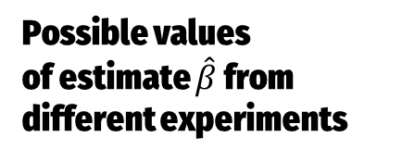
If treatment and control group are more representative, the effect distribution is more concentrated
_{β}
Possible values
of estimate $\hat{β}$ from different experiments
Larger samples or less outcome variation mean that individual estimates are closer to the true treatment effect.
Notes:
Stylized version: a distribution curve, with mean beta.
The benefit of randomization and statistics: if we know the variance of the outcomes in the sample, we know what the distribution of effect sizes around the true mean is.
Will use this to solve our problem: want to know if our effect estimate is a real effect, or just random variation.

Slide 31
Outline
True and Estimated Treatment Effect
Distribution of Treatment Effect Estimates
Hypothesis Testing
Statistical Power and Sample Size
Power in Clustered Designs
Calculating Power in Practice

Slide 32

Problem: We only see one estimate, from the experiment at hand. What do we conclude?
$$\hat{β}$$
The true treatment effect $β$ is unknown.

Slide 33
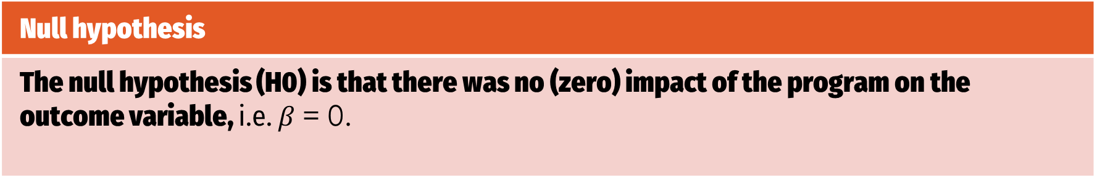
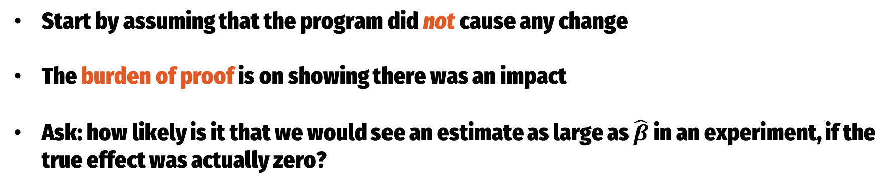
Hypothesis testing
Null hypothesis
The null hypothesis (H0) is that there was no (zero) impact of the program on the outcome variable, i.e. $β$ = 0.
Start by assuming that the program did not cause any change
The burden of proof is on showing there was an impact
Ask: how likely is it that we would see an estimate as large as $\hat{β}$ in an experiment, if the true effect was actually zero?
Notes:
If it is very unlikely, we can reject the null hypothesis.
”reverse the problem”: assume there is no effect and ask how plausible your beta hat is.

Slide 34
Distribution of estimates if the true effect is zero
₀
$$\hat{β}$$
Estimates as large or larger than this one are very unlikely
Assume a treatment effect of $β$ = 0.
Notes:
To determine

Slide 35

Distribution of estimates if the true effect is zero
But lower values may easily happen.
₀
$$\hat{β}$$
Assume a treatment effect of $β$ = 0.

Slide 36
Definition: Significance level
Type I error (false positive)
The probability of falsely concluding that there is a treatment effect. The probability of rejecting the null hypothesis (H0) that β = 0, even if it is true.
With any estimate, there will be some chance of a Type I error.
Significance level
The maximal probability of a Type I error we want to allow. 5% is most commonly used, but also 1% and 10%.
We say “$\hat{β}$is statistically significantly different from zero at the 5% level” if it is less than 5% likely that there is no effect.
Notes:
What do we mean by “very unlikely”?

Slide 37
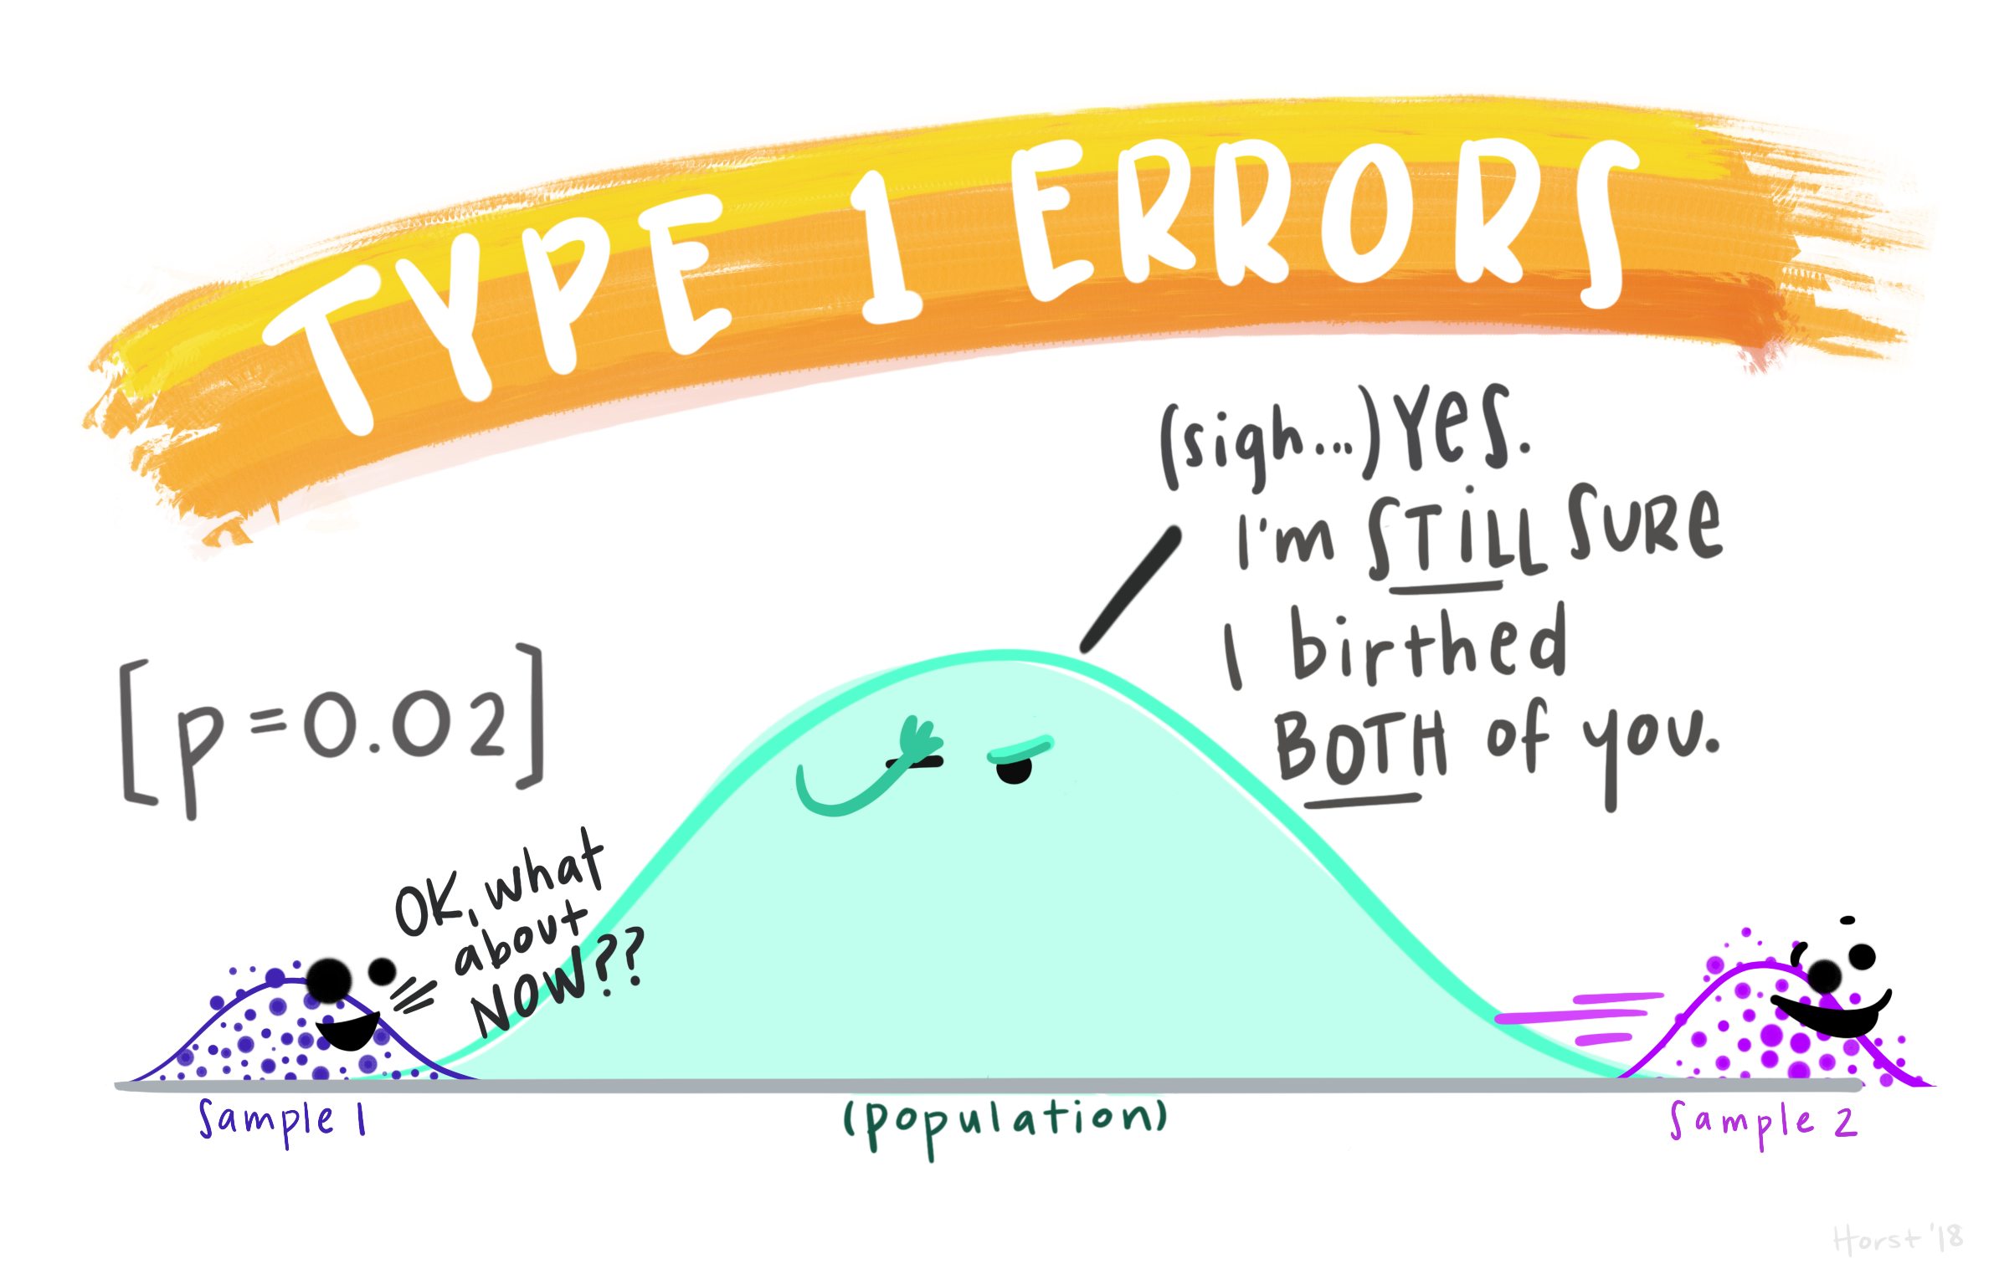
Notes:
https://allisonhorst.com/everything-else

Slide 38
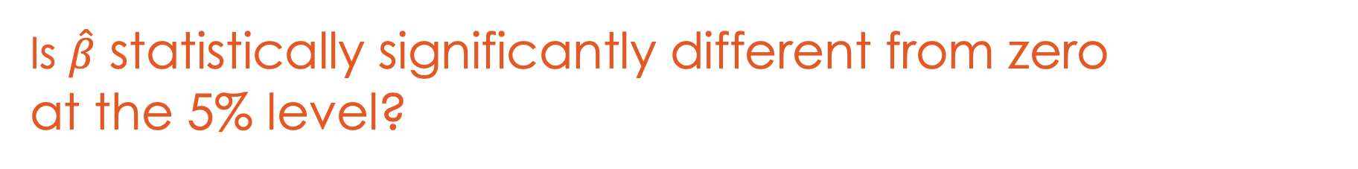
Is $\hat{β}$ statistically significantly different from zero at the 5% level?
₀
Reject null (< 5% likely)
Reject null (< 5% likely)
Only $\hat{β}$ that are large or small enough lead us to reject the null hypothesis of no treatment effect.

Slide 39
Is $\hat{β}$ statistically significantly different from zero at the 5% level?
₀
$$\hat{β}$$
Reject null (< 5% likely)
Reject null (< 5% likely)
Only $\hat{β}$ that are large or small enough lead us to reject the null hypothesis of no treatment effect.

Slide 40
Is $\hat{β}$ statistically significantly different from zero at the 5% level?
₀
$$\hat{β}$$
Reject null (< 5% likely)
Reject null (< 5% likely)
Only $\hat{β}$ that are large or small enough lead us to reject the null hypothesis of no treatment effect.

Slide 41

Critical values for $\hat{β}$
₀
Values closer to zero than the critical values have a probability of 95%, those further away have 5% probability.
Reject null (< 5% likely)
Reject null (< 5% likely)
The critical values give us a “cut-off” for $\hat{β}.$ The estimate is statistically significant at the 5% level if it lies outside the critical values.
Notes:
The critical values give us a “cut-off” for$\hat{β}.$

Slide 42

Critical values for $\hat{β}$
Critical value from Student t distribution for significance level α
Variance
Critical value
Sample Size
Proportion in
Treatment
The critical value will be closer to zero with
larger sample size N
smaller outcome variance σ
Notes:
The “magic” of statistics:
Can derive the critical value for beta_hat from a known number (t), and the sample sizes and variance of the sample
→ Dispersion of the outcome variable (test scores) around the mean of the control and treatment groups

Slide 43

Suppose you increase the sample size. For the same treatment estimate $\hat{β},$ is it more or less likely that the null is rejected?
More likely
Less likely
The probability is unaffected
Uncertain
Notes:
2 minutes
Correct answer: A
Discuss that the distribution will become more narrow
Critical values will move towards zero
Same beta may now be outside the CV
Ask: what other changes to the experiment would lead to the same effect?
Lower outcome variation
More even sample split

Slide 44
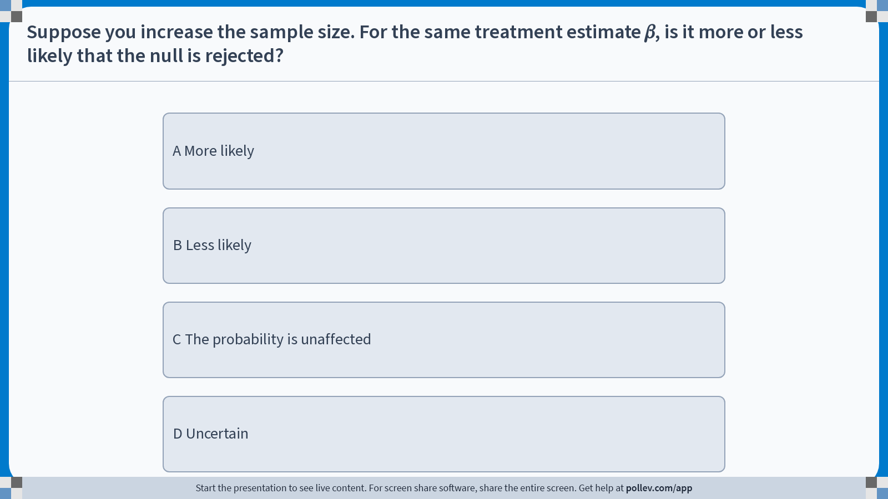
Notes:
Poll Title: Do not modify the notes in this section to avoid tampering with the Poll Everywhere activity. More info at polleverywhere.com/support Suppose you increase the sample size. For the same treatment estimate 𝛽, is it more or less likely that the null is rejected? https://www.polleverywhere.com/multiple_choice_polls/xQOUGdRp28LqLU8tYnJd1?display_state=instructions&activity_state=opened&state=opened&flow=Engagement&onscreen=persist

Slide 45
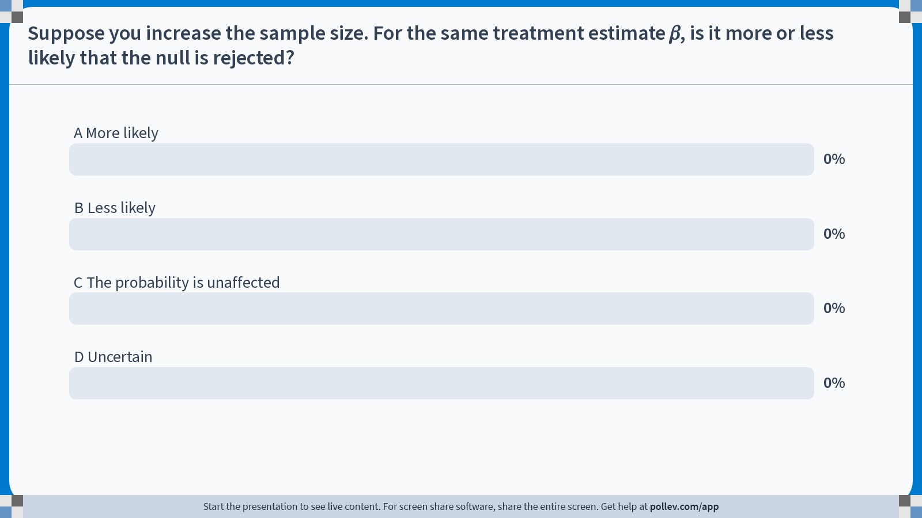
Notes:
Poll Title: Do not modify the notes in this section to avoid tampering with the Poll Everywhere activity. More info at polleverywhere.com/support Suppose you increase the sample size. For the same treatment estimate 𝛽, is it more or less likely that the null is rejected? https://www.polleverywhere.com/multiple_choice_polls/xQOUGdRp28LqLU8tYnJd1?display_state=chart&activity_state=opened&state=opened&flow=Engagement&onscreen=persist

Slide 46
Notes:
Poll Title: Do not modify the notes in this section to avoid tampering with the Poll Everywhere activity. More info at polleverywhere.com/support Suppose you increase the sample size. For the same treatment estimate 𝛽, is it more or less likely that the null is rejected? https://www.polleverywhere.com/multiple_choice_polls/xQOUGdRp28LqLU8tYnJd1?display_state=chart&activity_state=closed&state=closed&flow=Engagement&onscreen=persist

Slide 47
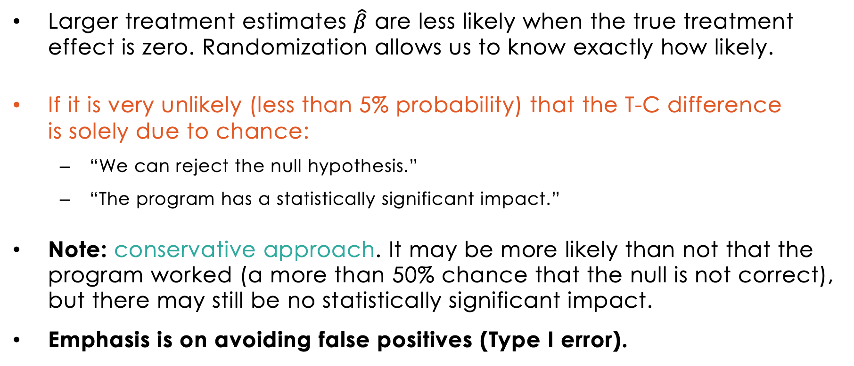
Hypothesis testing: Summary and conclusions
Larger treatment estimates $\hat{β}$ are less likely when the true treatment effect is zero. Randomization allows us to know exactly how likely.
If it is very unlikely (less than 5% probability) that the T-C difference is solely due to chance:
“We can reject the null hypothesis.”
“The program has a statistically significant impact.”
Note: conservative approach. It may be more likely than not that the program worked (a more than 50% chance that the null is not correct), but there may still be no statistically significant impact.
Emphasis is on avoiding false positives (Type I error).
Notes:
NOTE: concept of significance: acknowledges that our effect size from experiment is an estimate
We can never be 100% sure that there is an effect. But we can be pretty sure!

Slide 48
Outline
True and Estimated Treatment Effect
Distribution of Treatment Effect Estimates
Hypothesis Testing
Statistical Power and Sample Size
Power in Clustered Designs
Calculating Power in Practice

Slide 49
Definition: Type II error and statistical power
Type II error (false negative)
The probability of falsely concluding that there is no treatment effect. The probability of not rejecting the null hypothesis (H0), even if it is false.
Statistical Power
The probability of a correct positive. The probability of avoiding a Type II error.
Typically, we aim for 80% power (some aim for 90%)
Notes:
We said before that we are quite conservative – we need to be quite certain to conclude that there is a treatment effect.
But this puts us at the opposite risk: conclude there is no effect when there really is one.
The concept of power tells us how certain we can be that we will detect a true effect.

Slide 50
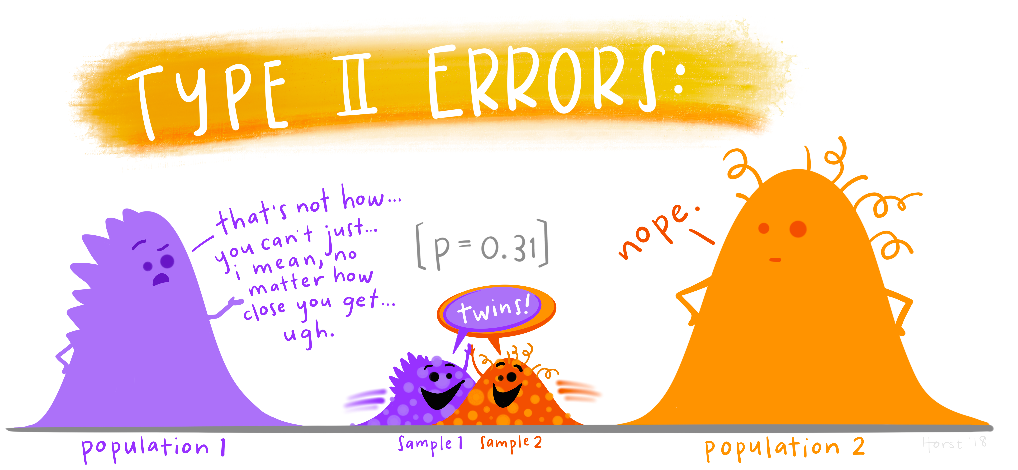
Notes:
https://allisonhorst.com/everything-else

Slide 51
If the true effect was β…
Critical value
_{β}
True effect=0
True effect=β
H₀
H_{β}
significance α=5%
The distribution of treatment effect estimates is given by H_{β}.
Notes:
Suppose we have chosen a significance level
Suppose the true treatment effect is actually beta.
H_beta describes distribution of treatment effect estimates.

Slide 52
… how often would we reject the null hypothesis?
Critical value
₀
_{β}
True effect=0
True effect=β
Power
H₀
H₀
H_{β}
H_{β}
significance α=5%
Shaded area shows power: probability that we obtain a treatment effect estimate which leads us to reject H₀ (when the true effect is β).
Notes:
There is at least some probability that the true effect is not zero (equals beta)
But we still get a treatment effect estimate close enough to zero that we make a Type II error: false negative.

Slide 53
Power is greater with a larger (true) treatment effect
Critical value
₀
_{β}
True effect=0
True effect=β
Power
H₀
H_{β}
significance α=5%
With low β, the null hypothesis is rarely rejected.
Notes:
Now suppose beta is small relative to the dispersion of the effect estimates:
Might falsely conclude there is no effect often.

Slide 54
Power is greater with a larger (true) treatment effect
Critical value
₀
_{β}
True effect=0
True effect=β
Power
H₀
H_{β}
significance α=5%
Greater effect size (relative to dispersion) means more power.

Slide 55
Power: Main ingredients
Effect size: a large effect is easier to distinguish from zero than a small effect.

Slide 56
Power: Main ingredients
Effect size: a large effect is easier to distinguish from zero than a small effect.
Variance: greater variability in the outcome variable makes it harder to distinguish an effect.
Notes:
Same as intuition as before: if the outcome varies a lot, independent of the treatment, the estimates will vary a lot.

Slide 57
Power: Main ingredients
Effect size: a large effect is easier to distinguish from zero than a small effect.
Variance: lower variability in the outcome variable makes it easier to distinguish an effect.
Sample size: a larger sample means that treatment and control are more representative of the overall population, making it easier to distinguish an effect.
Notes:
We can control sample size!

Slide 58
Power: Main ingredients
Effect size: a large effect is easier to distinguish from zero than a small effect.
Variance: greater variability in the outcome variable makes it harder to distinguish an effect.
Sample size: a larger sample means that treatment and control are more representative of the overall population, making it easier to distinguish an effect.
Sample split: an equal proportion in treatment and control makes it easiest to distinguish an effect.
Notes:
(And we can control the sample split)
May sound odd that we emphasize this – we’ll get back to this.
Ask the audience to think about reasons why you might choose an uneven sample split, despite an even split giving you greater power (for later)

Slide 59
Power: Main ingredients
Effect size: a large effect is easier to distinguish from zero than a small effect.
Variance: lower variability in the outcome variable makes it easier to distinguish an effect.
Sample size: a larger sample means that treatment and control are more representative of the overall population, making it easier to distinguish an effect.
Sample split: an equal proportion in treatment and control makes it easiest to distinguish an effect.
Notes:
Summary: four “main ingredients” for the power of our test.
Variance: we can look at outcome variation and estimate it.
Sample size and split: we can choose.
What is the problem? → we still don’t know the effect size!

Slide 60
Minimal Detectable Effect size
Minimal Detectable Effect (MDE)
The minimal true effect size needed to detect an effect with given statistical power (probability of correct positive), statistical significance (probability of a false positive) and sample size N.
Based on the MDE, can adjust the sample size to get to a realistic experimental design.
Notes:
Lesson from above:
- Probability of correctly detecting effect depends on (unknown) treatment effect size.
- We don’t know the effect size, but in order to calculate the right sample size we need to think about what the effect size might be.

Slide 61
Minimal Detectable Effect size (MDE)
Critical value
₀
True effect=0
True effect=β
H₀
significance α=5%
How far out must $β$ be so that we get κ = 80% power?

Slide 62
Minimal Detectable Effect size (MDE)
Critical value
₀
_{β}
True effect=0
True effect=β
Power
H₀
H_{β}
power κ
wanted: 80%
significance α=5%
How far out must $β$ be so that we get κ = 80% power?

Slide 63
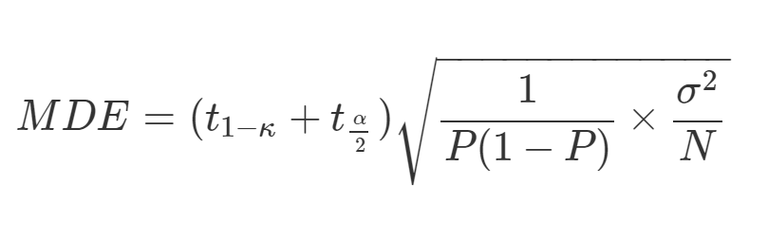
Minimal Detectable Effect size (MDE) for a two-sided test
Critical values from Student t for power κ and significance level α, where: t_{1-k} = k^{th} percentile of the t distribution.
Variance
Minimal detectable effect
Proportion in
Treatment
Sample Size
The MDE will be smaller with
larger sample size N
smaller outcome variance σ

Slide 64
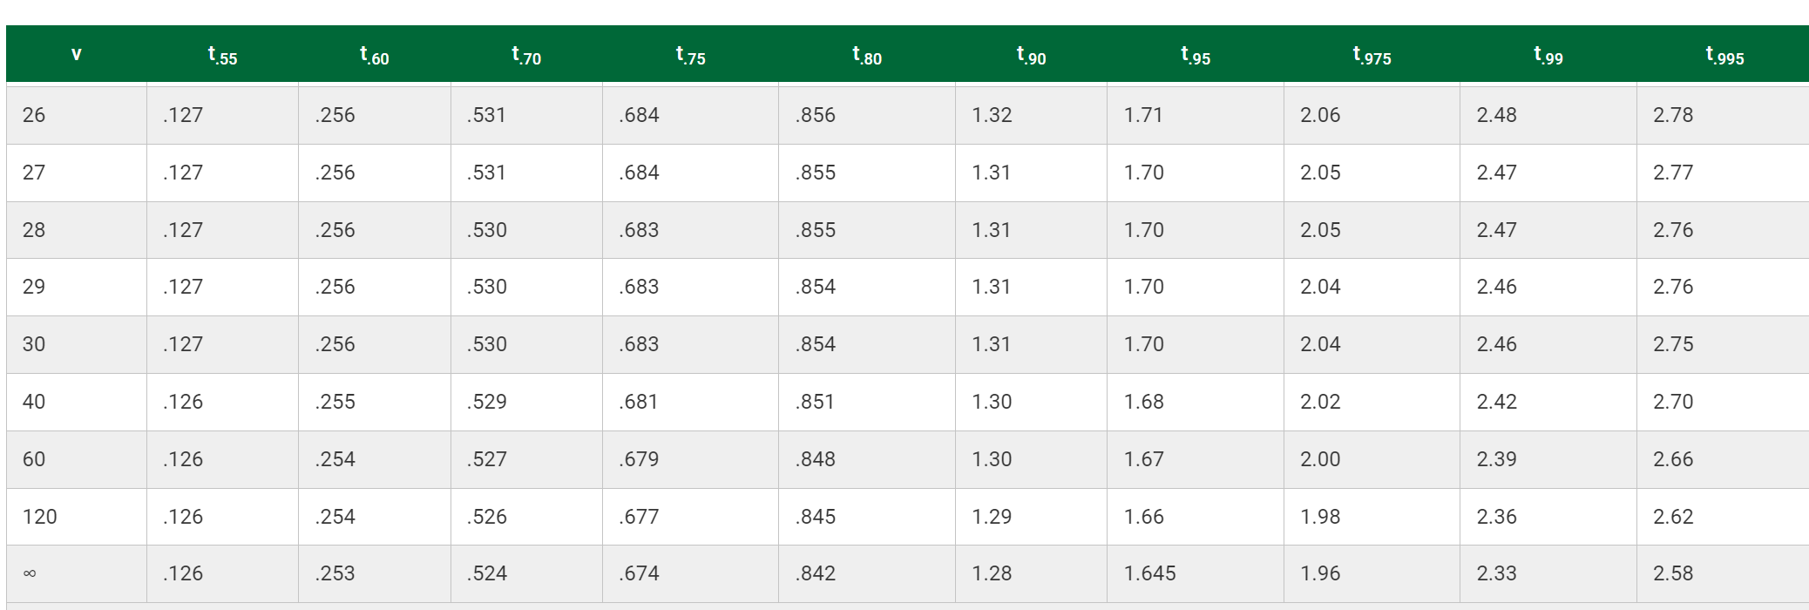

Slide 65
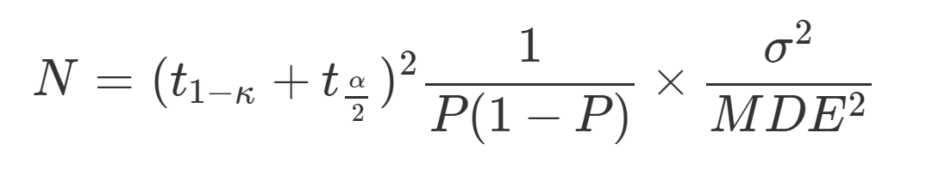
Alternatively, ask: what’s the N needed to detect a given MDE?
Critical values from Student t for power κ and significance level α
Variance
Sample Size
Proportion in
Treatment
Minimal detectable effect
The MDE will be smaller with
larger sample size N
smaller outcome variance σ

Slide 66
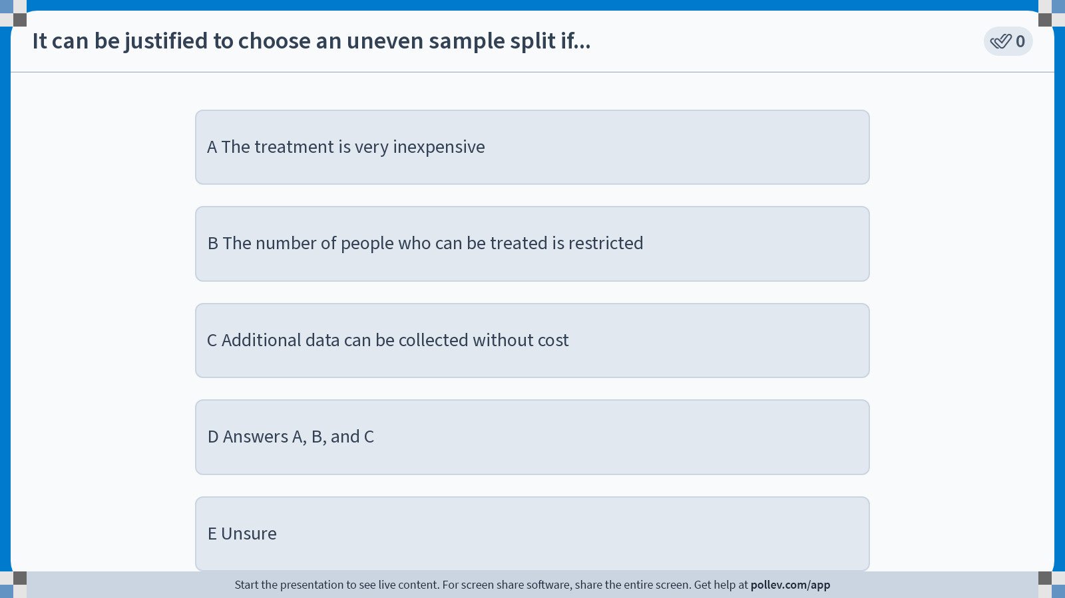
Notes:
Poll Title: Do not modify the notes in this section to avoid tampering with the Poll Everywhere activity. More info at polleverywhere.com/support It can be justified to choose an uneven sample split if... https://www.polleverywhere.com/multiple_choice_polls/QfiCLKw8VQFakfqpBJhtx?display_state=instructions&activity_state=opened&state=opened&flow=Engagement&onscreen=persist

Slide 67
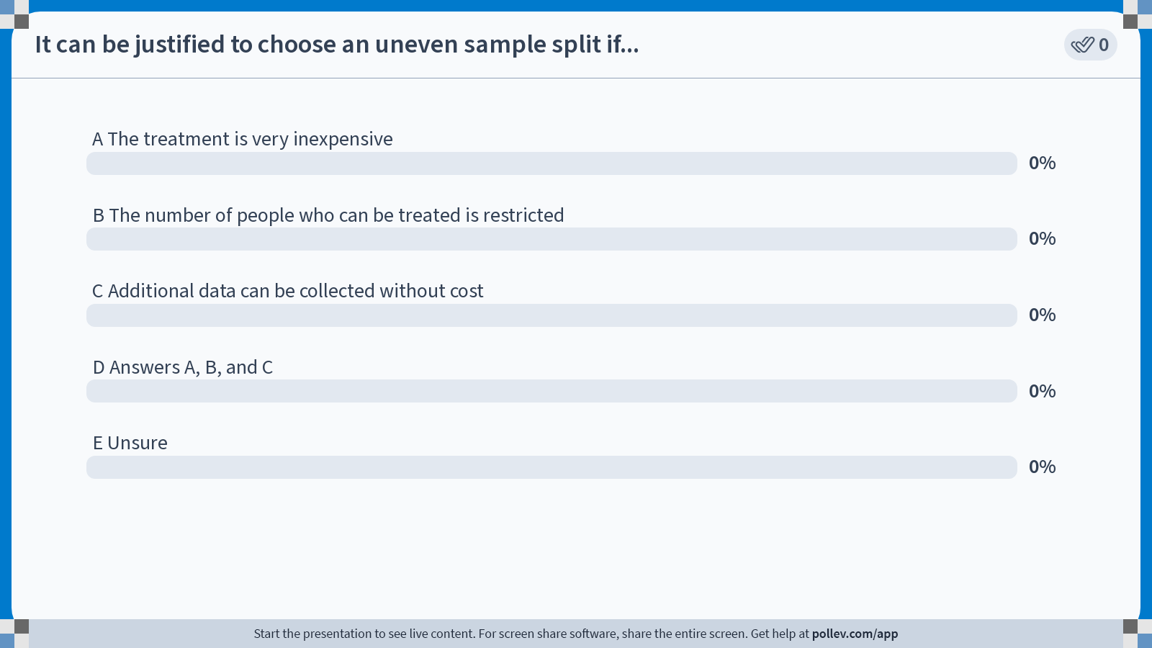
Notes:
Poll Title: Do not modify the notes in this section to avoid tampering with the Poll Everywhere activity. More info at polleverywhere.com/support It can be justified to choose an uneven sample split if... https://www.polleverywhere.com/multiple_choice_polls/QfiCLKw8VQFakfqpBJhtx?display_state=chart&activity_state=opened&state=opened&flow=Engagement&onscreen=persist

Slide 68
Notes:
Poll Title: Do not modify the notes in this section to avoid tampering with the Poll Everywhere activity. More info at polleverywhere.com/support It can be justified to choose an uneven sample split if... https://www.polleverywhere.com/multiple_choice_polls/QfiCLKw8VQFakfqpBJhtx?display_state=chart&activity_state=closed&state=closed&flow=Engagement&onscreen=persist

Slide 69
Outline
True and Estimated Treatment Effect
Distribution of Treatment Effect Estimates
Hypothesis Testing
Statistical Power and Sample Size
Power in Clustered Designs
Calculating Power in Practice
Notes:
An outlook: power depends on other design parameters as well.
Here we only looked at a fairly straightforward case, but oftentimes it requires some more involved calculations to conduct power calculations. → get help from a researcher!
Just one common example: clustering.
Clustered designs: ask audience what they are.

Slide 70
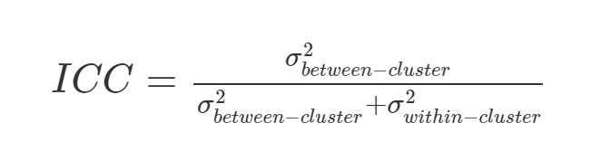
Definition: Intra-Class Correlation (ICC)
Null hypothesis
The intra-class (or “intra-cluster”) correlation is the correlation among units within the same group. The ICC is also the fraction of total variation accounted for by between-group variation.
Total variance(σ²) can be divided into within-cluster variance (σ_{η}²) and between-cluster variance (σ_{ν}²).
High ICC (close to 1): similar subjects are likely in the same cluster; different clusters tend to be very different from each other.
Low ICC (close to 0): different clusters are likely similar to each other.
Notes:
High ICC: all variation is between clusters.
Low ICC: all variation is within clusters.
Hold off for some intuition….

Slide 71
Intuition: How does the ICC affect power?
Samples with high intra-class correlation have similar individuals in each cluster, but different clusters are dissimilar.
Comparison
Random sampling
Treatment

Slide 72
Intuition: How does the ICC affect power?
Samples with low intra-class correlation tend to have more similar clusters, and resemble the population as a whole more closely.
Comparison
Random sampling
Treatment
Notes:
Ask the audience: can you guess how a high ICC affects power?
Answer is that it reduces power: if they find that difficult, ask how a high ICC will affect the dispersion of treatment effect estimates.
Use that high ICC means even a large sample might not be very representative of the total population – high variance of estimates.

Slide 73
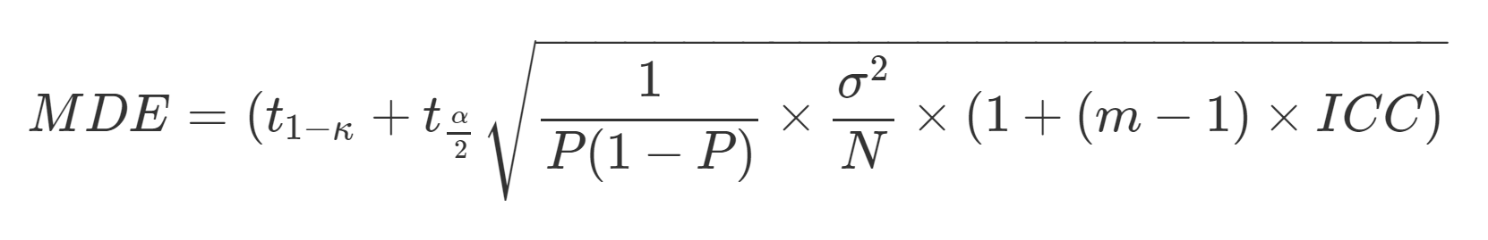
Minimal Detectable Effect size (MDE)
Critical values from Student t for power κ and significance level α
Variance
Intraclass correlation
Cluster Size
Minimal detectable effect
Proportion in Treatment
Sample Size
The MDE will be smaller with
larger sample size N
smaller outcome variance σ
lower ICC

Slide 74
Outline
True and Estimated Treatment Effect
Distribution of Treatment Effect Estimates
Hypothesis Testing
Statistical Power and Sample Size
Power in Clustered Designs
Calculating Power in Practice

Slide 75
Power calculations step-by-step
Set desired power (default: 80%) and significance level (default: 5%).
Decide allocation ratio (sample split), e.g., based on the cost of data collection and the intervention.
Determine a plausible MDE: what treatment effect is likely?
Estimate remaining variance (after controlling for covariates) & ICC.
Factor in attrition.
Back out the sample size (analytically or with simulations).
Notes:
When planning an evaluation, with some preliminary research we can calculate the minimum sample we need to get to:
Test a pre-specified null hypothesis (e.g. treatment effect 0)
For a pre-specified significance level (e.g. 0.05)
Given a pre-specified effect size (e.g. 0.2 standard deviation of the outcomes of interest).
To achieve a given power
A power of 80% tells us that, in 80% of the experiments of this sample size conducted in this population, if Ho is in fact false (e.g. the treatment effect is not zero), we will be able to reject it.
The larger the sample, the larger the power.
Common Power used: 80%, 90%

Slide 76
Estimating variance and the intra-cluster correlation (ICC)
MDE/ sample size for straightforward sampling designs can be calculated according to the formulas above
For complex sampling designs (and better intuition): use simulation
Estimate within- and between-cluster variance of the outcome variable
Check sensitivity of power calculations to different possible ICC values
Note: where to find data on outcome variable variance?
J-PAL and IPA Dataverses, World Bank Microdata Catalogue
IPUMS or DHS data (large health and population household surveys)
Own data from program implementation
Also, see https://educ265.de-barros.com/resource/data
Notes:
Emphasize here that involvement of a researcher is beneficial.
Statistician or economist, political scientist.
They can also suggest methods to improve power even if the sample can’t be increased, e.g. by including covariates etc.

Slide 77
Ex-post power calculations are a bad idea
What should you do after completing your study?
Just look at your standard errors, calculate the confidence interval for your effects, maybe report the effects you can rule out
If you really want to know the MDE (e.g., to plan your next study): Just calculate MDE = 2.8 * the observed standard error
Additional resources on this topic
See https://blogs.worldbank.org/impactevaluations/why-ex-post-power-using-estimated-effect-sizes-bad-ex-post-mde-not
Notes:
Emphasize here that involvement of a researcher is beneficial.
Statistician or economist, political scientist.
They can also suggest methods to improve power even if the sample can’t be increased, e.g. by including covariates etc.

Slide 78
Plan ahead
DAM 2
Due on Tuesday
Reading reactions
Due on Wednesday
Milestone 2
Due on March 03
78

Slide 79
Balsakhi endline data: normalized combined test scores in treatment and comparison groups.
Average scores in C and T
The average score in the treatment group is 0.27 higher.
Notes:
There is a lot of dispersion in scores
Clearly other factors besides extra teachers affect test scores
We can see that the treatment group distribution in blue is shifted to the right, but the shift is small relative to the dispersion

